Slide 1
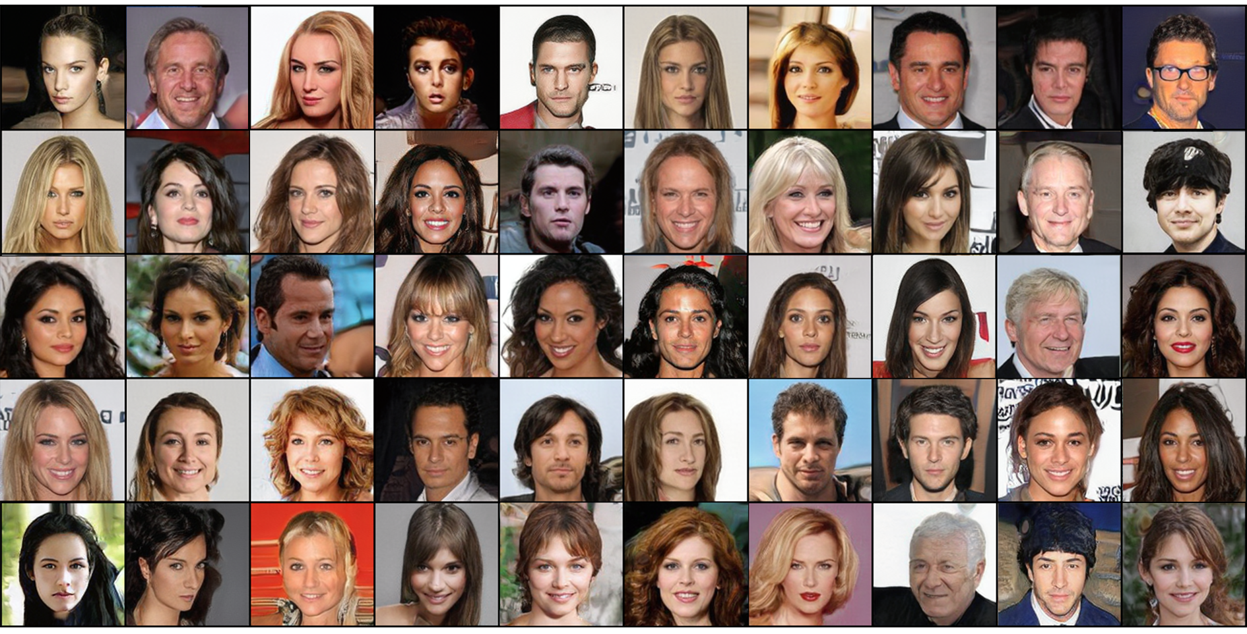
StyleGAN
Paper by: Karras et al (2019)
Presentation by: Yael & Shahar

Slide 2
Agenda
Introduction
Motivation
Architecture
Training process + limitations
Results

Slide 3

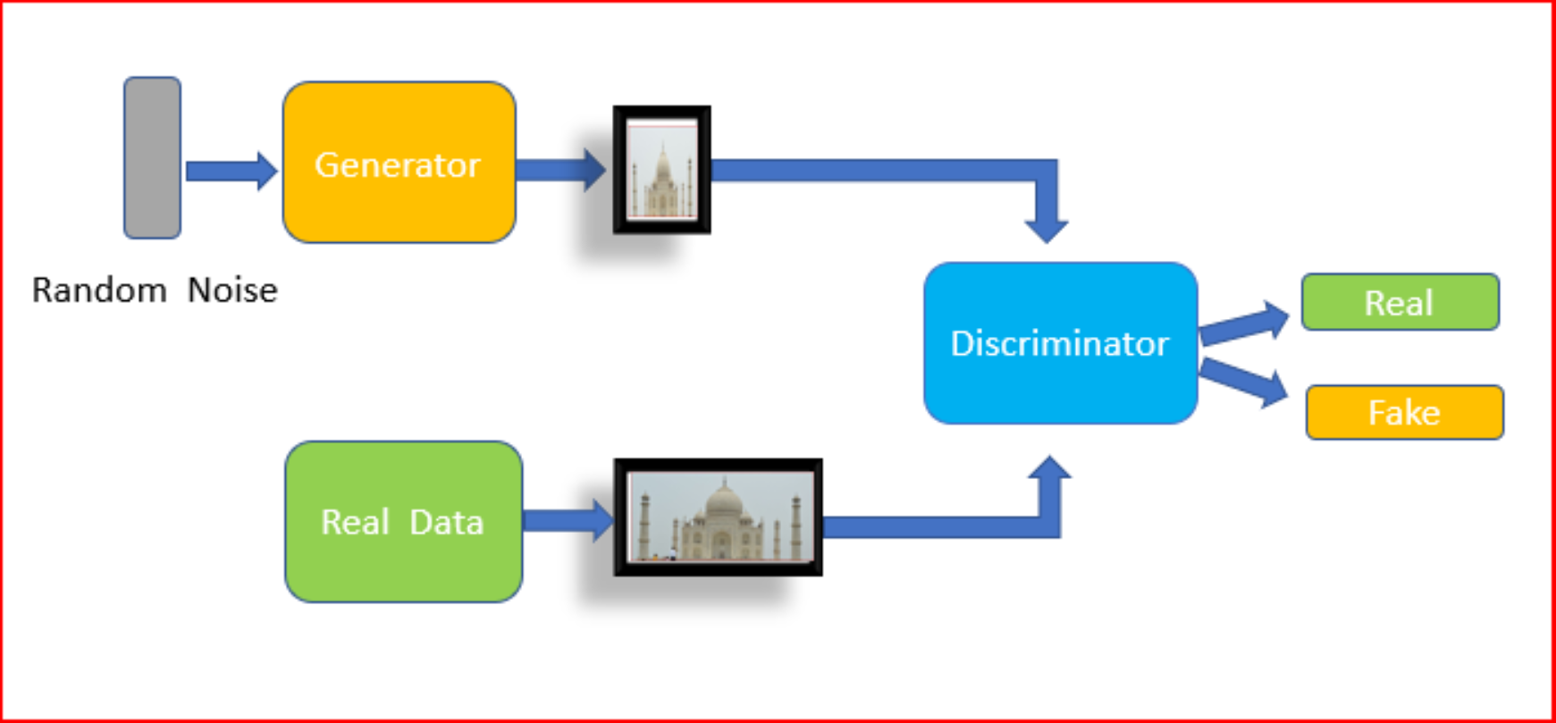
Introduction to GAN (quickly)
A competition between Generator and Discriminator

Slide 4
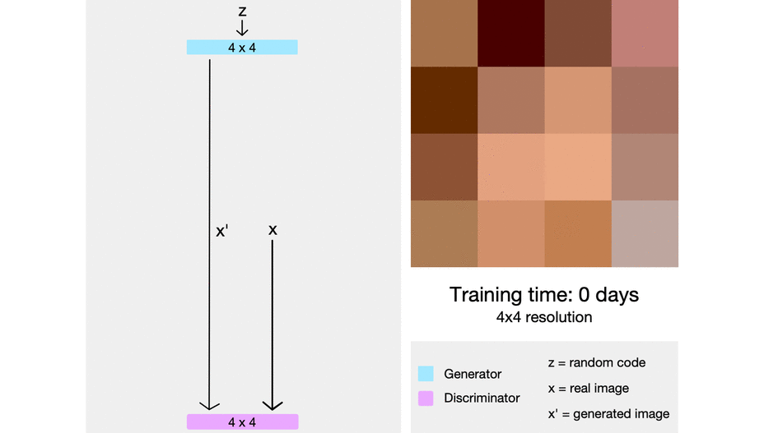
GAN for image generation - ProGAN
The goal is to create higher resolution images.
Train on low-res images and gradually increase resolution (upsample)
Allows stable training & higher quality

Slide 5

Motivation for StyleGAN architecture
Hard to monitor where every aspect comes from
Therefore, We want to separate content and style of an image.
So instead of generating images directly from noise, StyleGAN modifies style features at different layers
This allows more control over the images

Slide 6
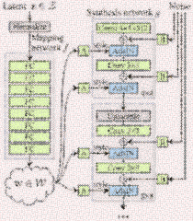
The architecture
What’s new? The Generator!
Initial mapping
Start from 4X4 constant
AdaIN
Style Mixing

Slide 7
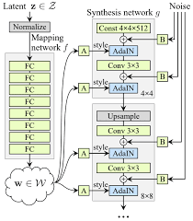
The architecture
Initial mapping
Instead of using z directly, it passes it through an 8-layer fully connected network (MLP) called the Mapping Network.
This w creates a better-structured latent space
This will make sure that the generator in more robust and not trained over initial chaos.

Slide 8
The architecture
Start from 4X4 constant
First we train over a constant 4X4 feature map
This is the first low-res layer.
Allows us to get a more stable and reproducible result
Allows the network to learn the initial structure first – which will make the style learning easier.

Slide 9
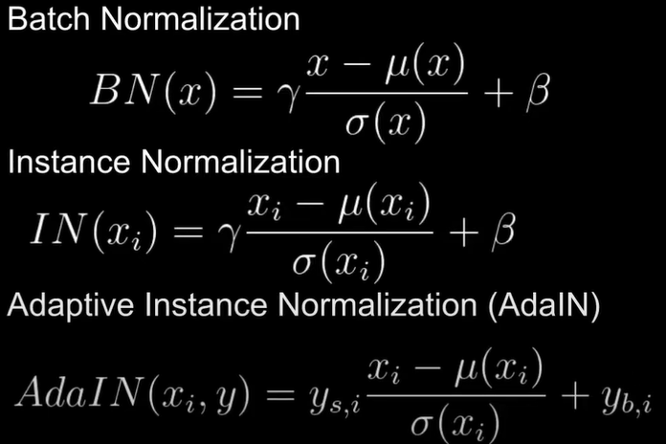
The architecture
AdaIN
Normalizing, but now we inject noise and styles.
Allowing the control of style at different layers!
Disentangles high and low level resolutions (facial shape vs texture and color)

Slide 10

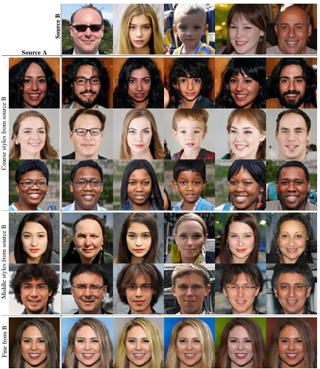
The architecture
Style Mixing
Instead of using a single latent vector w for the entire image, StyleGAN can combine different latent vectors for different layers of the generator.

Slide 11
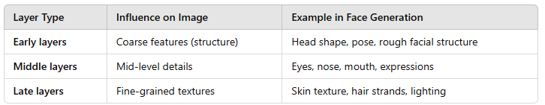
The architecture
Style Mixing

Slide 12
The architecture
Style Mixing + Paper’s results

Slide 13

The training process
Long
Around 25 mins per epoch (for us)
StyleGAN saw good results initially after 920 epochs
Inconsistent
We will show examples soon ☺

Slide 14

Our Limitations
NVIDIA had a full week of training over 8 V100 GPUs ☺
We have 3 hours a day, using 1 T4 ☹
The solution:
Generating 128X128 instead of 1024X1024!
Smaller training and way less complex network (due to progressive GAN)

Slide 15
Our Limitations
The solution:
Generating 128X128 instead of 1024X1024!
Smaller training and way less complex network (due to progressive GAN)
NVIDIA had a full week of training over 8 V100 GPUs ☺
We have 3 hours a day, using 1 T4 ☹

Slide 16

Here are our results:
Creepy images alert!!!!

Slide 17
Here are our results:
Creepy images alert!!!!

Slide 18

Epoch
0

Slide 19
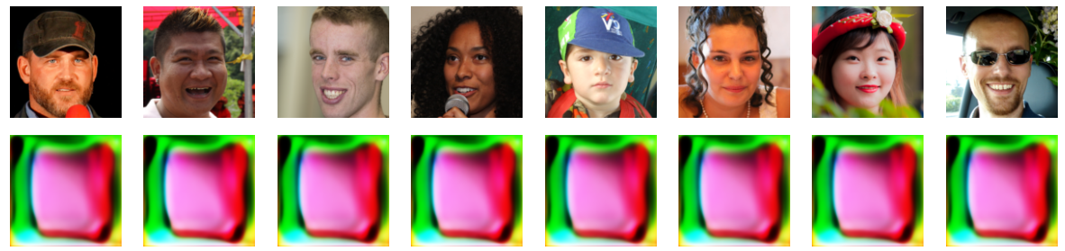
Epoch
1

Slide 20
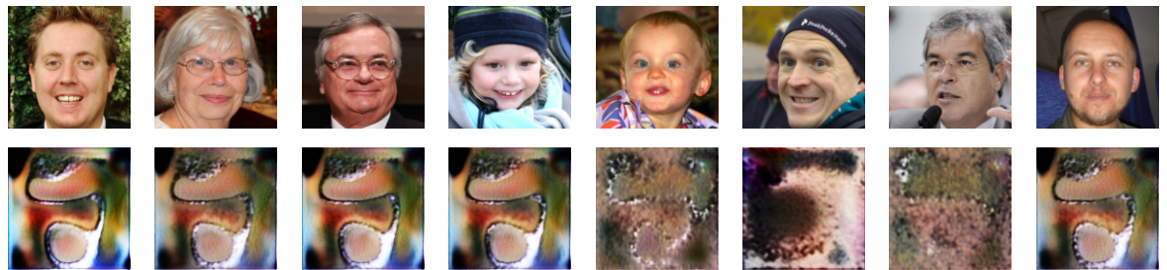
Epoch
7

Slide 21
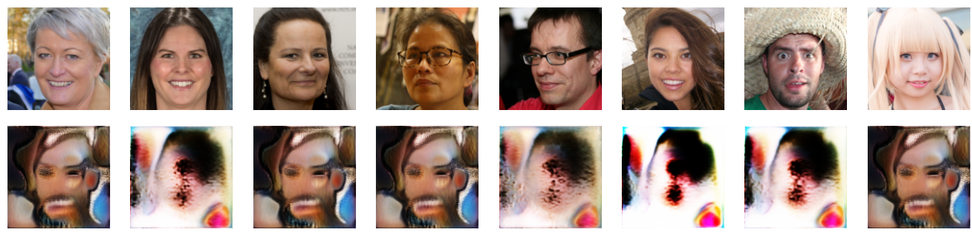
Epoch
11

Slide 22
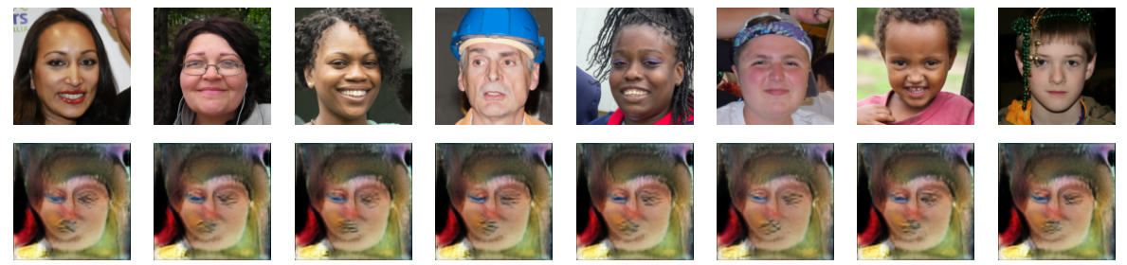
Epoch
15

Slide 23
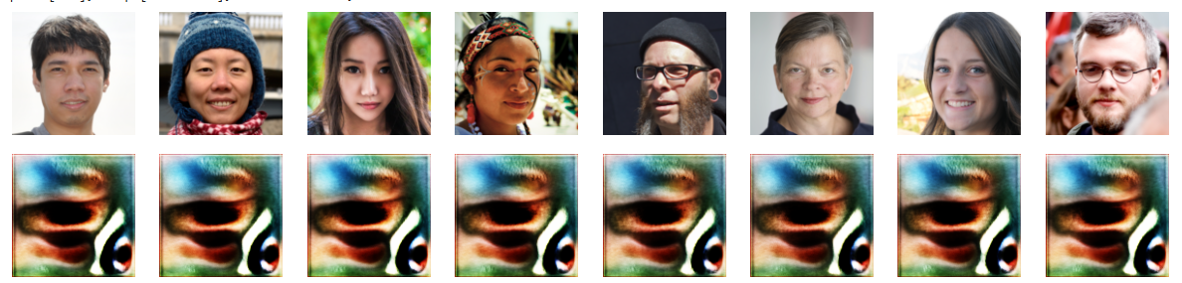
Epoch
19

Slide 24
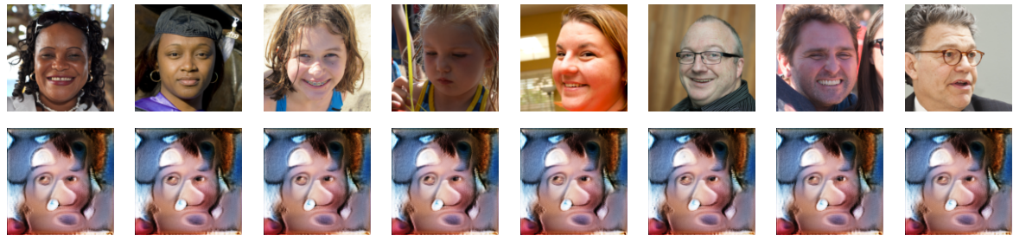
Epoch
22

Slide 25
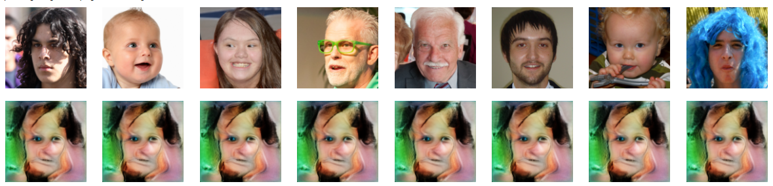
Epoch
30

Slide 26
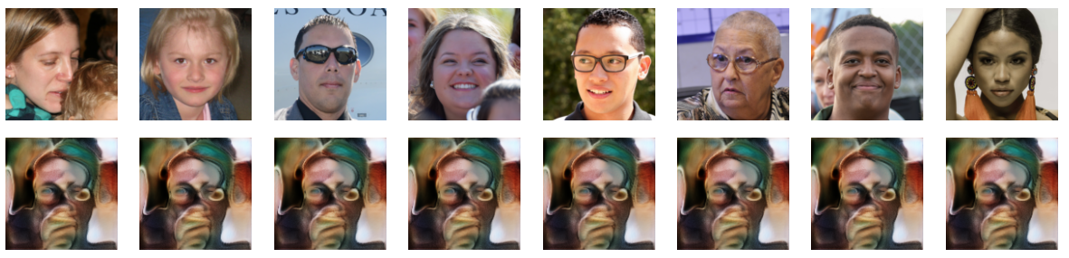
Epoch
35 – Last one (for now)

Slide 27
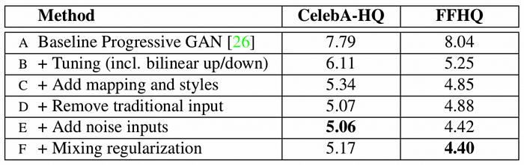
Paper results

Slide 28




Questions?

